Slide 1
Topic: U3L1 Graphing
Exponential Functions
EQ: What are the key parts of the graph of an exponential function?

Slide 2
Exponential Functions

Slide 3

First, let’s take a look at an
exponential function
x | y
0 | 1
1 | 2
2 | 4
-1 | 1/2
-2 | 1/4

Slide 4
So our general form is simple enough.
The general shape of our graph will be determined by the exponential variable.
Which leads us to ask what role does the ‘a’ and the base ‘b’ play here. Let’s take a look.

Slide 5
First let’s change the base b
to positive values
What conclusion can
we draw ?

Slide 6
Next, observe what happens when b assumes a value such that 0 < b < 1.
Can you explain why
this happens ?

Slide 7
What do you think
will happen if ‘b’ is negative ?

Slide 8
Don’t forget our
definition !
Any equation of the form:
Can you explain why ‘b’ is restricted from assuming negative values ?

Slide 9
To see what impact ‘a’ has on our graph
we will fix the value of ‘b’ at 3.
What does a larger
value of ‘a’
accomplish ?

Slide 10
Shall we speculate as to what happens when ‘a’ assumes negative values ?
Let’s see if you are correct !

Slide 12
Our general exponential form is
  “b” is the base of the function and changes here will result in:
    When b > 1, a steep increase in the value of ‘y’ as ‘x’ increases. This is known as “exponential growth.”
    When 0 < b < 1, a steep decrease in the value of ‘y’ as ‘x’ increases. This is known as “exponential decay.”

Slide 13
We also discovered that changes in “a” would change the y-intercept on the corresponding graph.

Slide 14
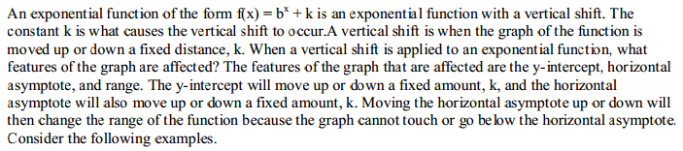
Graphing an Exponential Function with a Vertical Shift

Slide 15
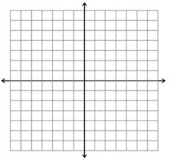
Example 1—Graph f(x) = 2^{x} + 1

Slide 16
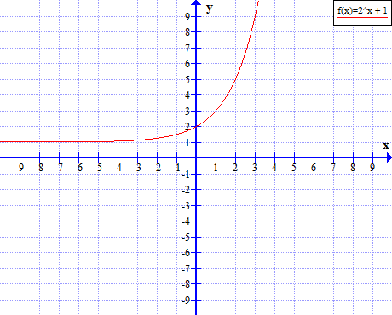
Example 1—Graph f(x) = 2^{x} + 1

Slide 17
You Try Examples
y = 3^{x} – 1
y = 2^{x} + 2
y = 2(⅖)^{x} - 3

Slide 18
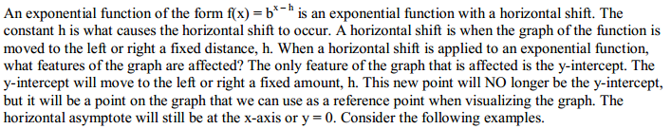
Graphing an Exponential Function with a Horizontal Shift

Slide 19
Example 2—Graph f(x) = (3/2)^{x+1}

Slide 20
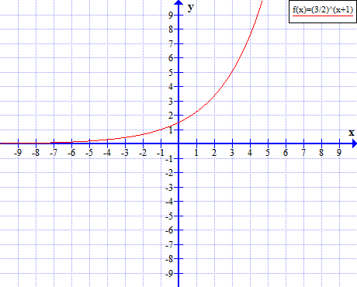
Example 2—Graph f(x) = (3/2)^{x+1}

Slide 21
You Try Examples
y = (2/3)^{x-2}
y = (7/4)^{x+1}
y = 2 ^{x-3}

Slide 22
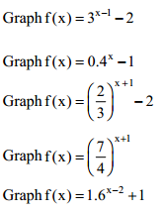
Shifting in Both Directions

