Slide 1
Solving Quadratics
By Factoring

Slide 2
Solve by Factoring
2x^2 – 4x + 2

Slide 3
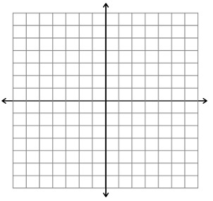
Graph to check

Slide 4
Solve by Factoring
16x^2 - 4

Slide 5
Graph to check

Slide 6
Solve by Factoring
2x^2 – 4x

Slide 7
Graph to check

Slide 8
Solving with Square roots
X^2 = 16
2x – 1 = 17
2(x – 1)^2 = 32

Slide 9
Classwork

Slide 10
Complex Numbers
Using imaginary roots we can find the square root of a negative number:

Slide 11
Practice

Slide 12
Homework

