Slide 1
Shifts of Exponential Graphs

Slide 2
Graphing an Exponential Function with a Vertical Shift

Slide 3
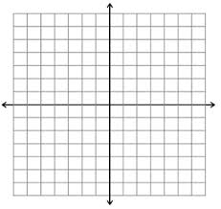
Example 1 – Graph f(x) = 2 ^{x} + 1.

Slide 4
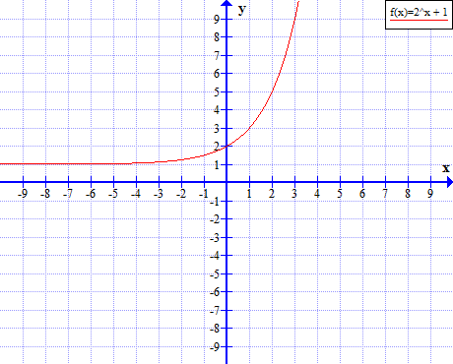
Example 1 – Graph f(x) = 2 ^{x} + 1.

Slide 5
You try examples:
y = 3^{x} – 1
y = 2^{x} + 2
y = 2(⅖)^{x} - 3

Slide 6
Graphing an Exponential Function with a Horizontal Shift

Slide 7
Example 2: Graph f(x) = (3/2) ^{x+1}

Slide 8
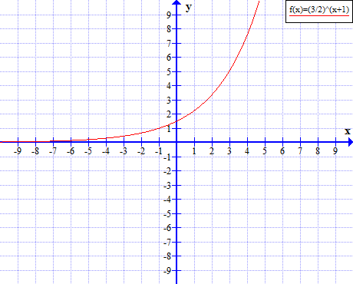
Example 2: Graph f(x) = (3/2) ^{x+1}

Slide 9
You try
y = (2/3)^{x-2}
y = (7/4)^{x+1}
y = 2 ^{x-3}

Slide 10
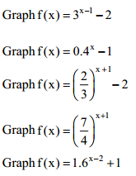
Shifting both ways

