Slide 1
Common Logarithms, Base e, Natural Logs, Properties of Logarithms

Slide 2
Common Logs
The logarithmic function with base b, where b > 0, (and b is not equal to 1), is written y = log _{b} x, and is defined as y = log _{b} x if and only if x = b^{y}.
The logarithm of base 10 is known as the common logarithm, and is written y = log ₁₀ x = log x. If no base is provided, then it is an assumed base of 10.

Slide 3
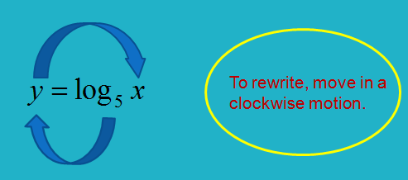
Rewriting
Write y = log ₅ 25 = 2 in exponential form.
Start with 5 and move in a counterclockwise motion to the y then equal 25: 5^{y} = 25
Write 3³ = 27 in logarithmic form.
Do the reverse of above: log ₃ 27 = 3

Slide 4
Natural Logarithms
The natural logarithmic function is written y = ln x = log _{e} x and is defined as y = ln x if and only if x = e^{y}.
Notice that this function is just a special case of the logarithmic function we defined earlier, with a base of the irrational number e. Its graph behaves just like all other logarithmic functions with a base greater than 1, and the function is often used in modeling real-world phenomena. The domain of the function is all real numbers greater than 0, and its range is all real numbers.

Slide 5
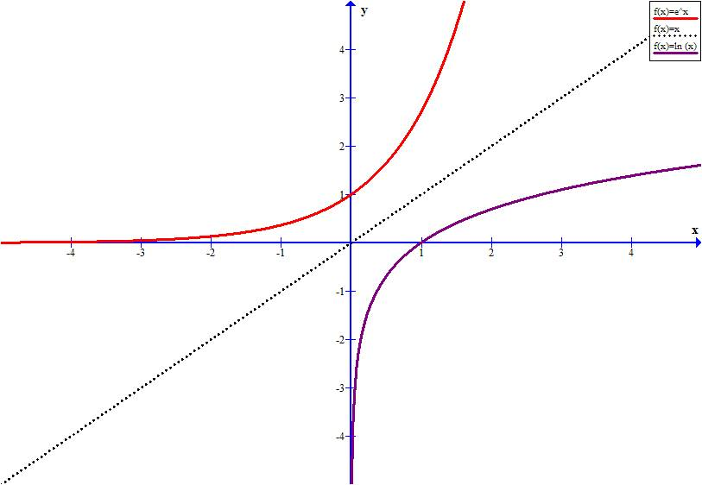

Slide 6
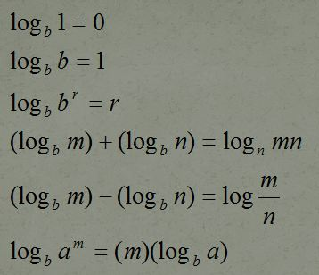
Properties of Logs
Just as with exponential functions, logarithms have certain properties that allow us to manipulate expressions involving them. Look at the properties listed. Assume that b > 0 (b is not equal to 1) and m & n are real numbers.

Slide 7
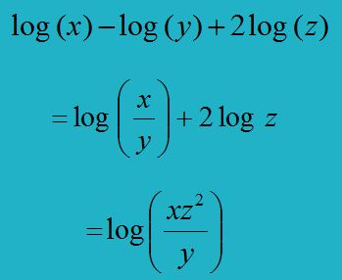
Condense
Rewrite the following expressions using a single logarithm - condense.
the minus means divide, the plus means multiply, the 2 becomes an exponent.

Slide 8
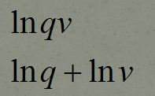
Expand
Expand:
multiplication becomes a +
division becomes a –
the exponent becomes a number in front

Slide 9
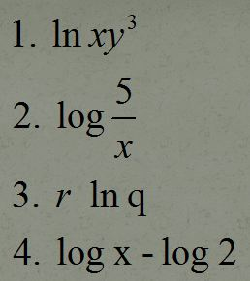
Practice
Let’s practice condensing and expanding

Slide 10
Change of Base
Texas Instruments graphing calculators can only operate in base 10. If you need to put a logarithm into your calculator (to graph or evaluate) you need to use the change of base formula. It is as follows:

Slide 11
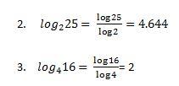
Example
1. log ₃ 7
type it into your calculator as (log 7)/(log 3) and press enter
1.771

