Slide 2
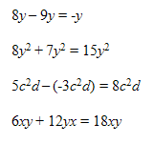
We can only add and subtract like terms. Remember that like terms have the same variables raised to the same powers.
When we combine like terms, our exponents remain the same. For example, x² added to 7x² is 8x², not 8x⁴. Look at the graphic to see some other examples of like terms.

Slide 3
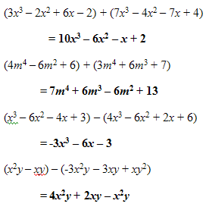
When adding and subtracting polynomials, we will add and subtract like terms. We will also write our answer in standard form—that is, with our terms written in order from greatest degree to least degree.
Be careful when subtracting! You must subtract everything after the minus sign.
Work through the examples shown to practice adding and subtracting like terms.

Slide 4
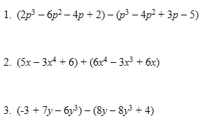
Now it’s your turn to try! Simplify the expressions shown. Then, turn the page to check your answers.

Slide 5
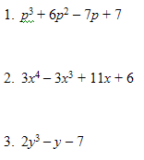

Slide 6
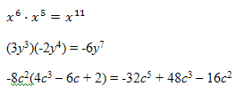
When multiplying polynomials, we must remember to add exponents whenever we multiply like bases.
Look over the examples shown for a quick review.

Slide 7
Let’s practice multiplying polynomials:

Slide 8
More Practice:

